Slide 1
Architectural Design
Architectural Design
Design the software architectural model for the online shopping mall where the model is defined in terms of subsystems and their interactions. Each subsystem should be represented with objects supporting the subsystem. Define the communication styles between subsystems.
Develop a running prototype. You need to implement the software using object-oriented language such as C++, C#, or Java. The prototype should have two functionalities designated by the instructor. GUI is NOT required
Notes:
Make sure each component is reusable , makes sure each works independently, don’t put everythong in one class. Use inheritance, different classes. It should be secure .

Slide 2
Software Architecture
Software architecture
Components (subsystems) and interaction between the components
Insecure components and interaction
Develop integrated communication diagram
Application objects and their interactions
Merge all communication diagrams for use cases
Define software architecture for applications
In terms of components (subsystems) and interactions
Software architecture for applications first
e.g., SOA, client/server, and so on
Define communication style between subsystem

Slide 3
Transition from Analysis to Design: Develop initial software architecture (high level design)
Start with dynamic interaction model
Use case based interaction diagrams
Sequence diagrams
Communication diagrams
Integrate use case based interaction diagrams
Initial version of software architecture
Structure system into subsystems
Subsystem contains multiple objects
Depict subsystems on subsystem communication diagram
High-level communication diagram
Shows subsystems and their interactions
Use stereotypes for subsystem structuring criteria

Slide 4
Transition from Analysis to Design: Integration of Communication Diagrams
Integration of communication diagrams
To determine overall structure of system
Merger of communication diagrams
Start with first communication diagram
Superimpose other communication diagrams
Add new objects and new message interactions from each subsequent diagram
Objects and interactions that appear on multiple diagrams are only shown once
Consider alternative scenarios for each use case
Integrated communication diagram
Shows all objects and their interactions

Slide 5
Characteristics of Integrated Communication Diagram – ATM Client
For clarity
Sequence numbers are removed
Individual messages between objects can be aggregated
E.g., between ATM Control and Customer Interaction
Aggregate message = Display Prompts
Consists of simple messages
Get PIN, Invalid PIN Prompt, Display Menu, etc.
E.g., between ATM Client and Banking Service
Aggregate message = ATM Transactions
Consists of simple messages
PIN Validation Transaction, Withdrawal Transaction, Query Transaction, Transfer Transaction

Slide 6
Design of Client/Server Systems
Client Subsystem sends request to Service Subsystem
Waits for response
Service Subsystem
Receives Client requests
Processes each Client request in the order received
First-In First-Out (FIFO)
Sends response to Client

Slide 7
Example of Integration of communication Diagrams - Banking System
Client/Server architecture
Multiple ATM Clients
Banking Service
Processes ATM client requests
Develop subsystem communication diagram
Banking System
Develop integrated communication diagram for each subsystem
ATM Client
Banking Service
Start from use case based communication diagrams
Validate PIN
Withdraw Funds
Etc.

Slide 8
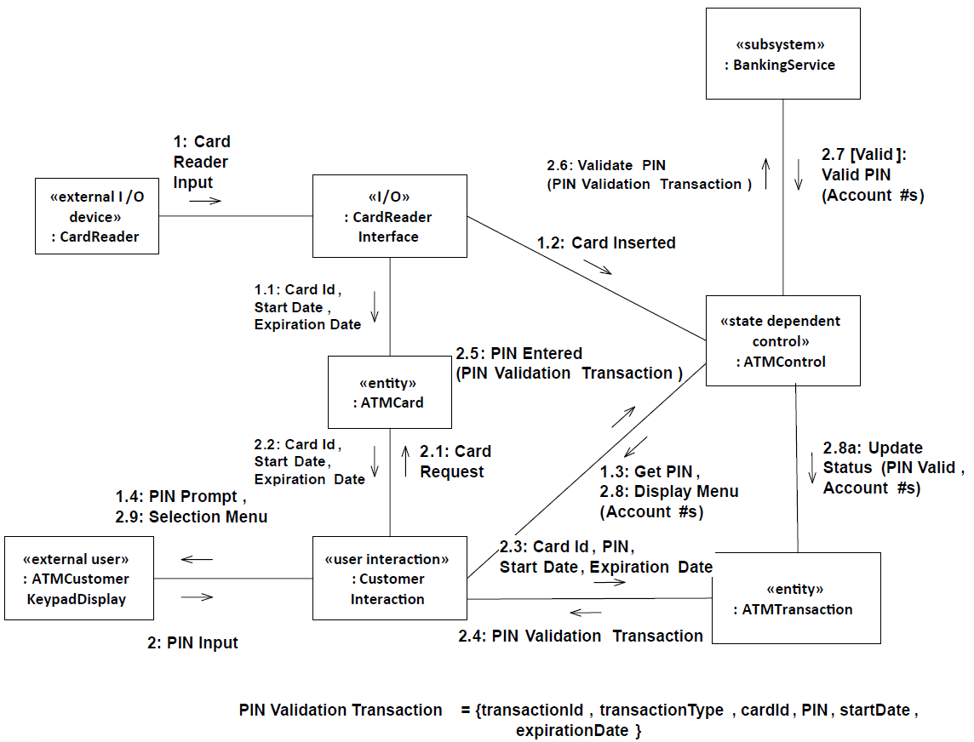
Communication diagram: ATM Client – Validate PIN use case – Valid Pin

Slide 9
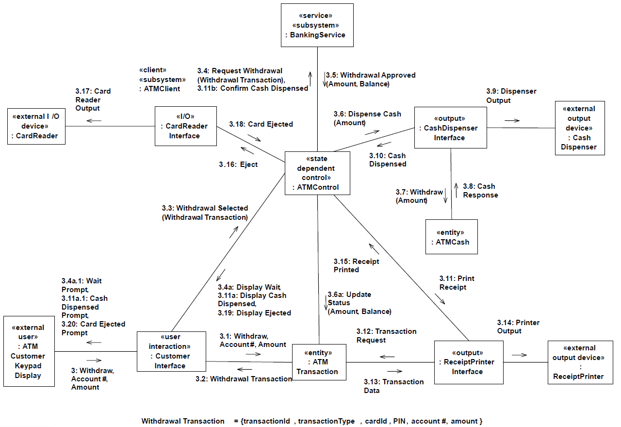
Communication diagram: ATM Client – Withdraw Funds use case

Slide 10
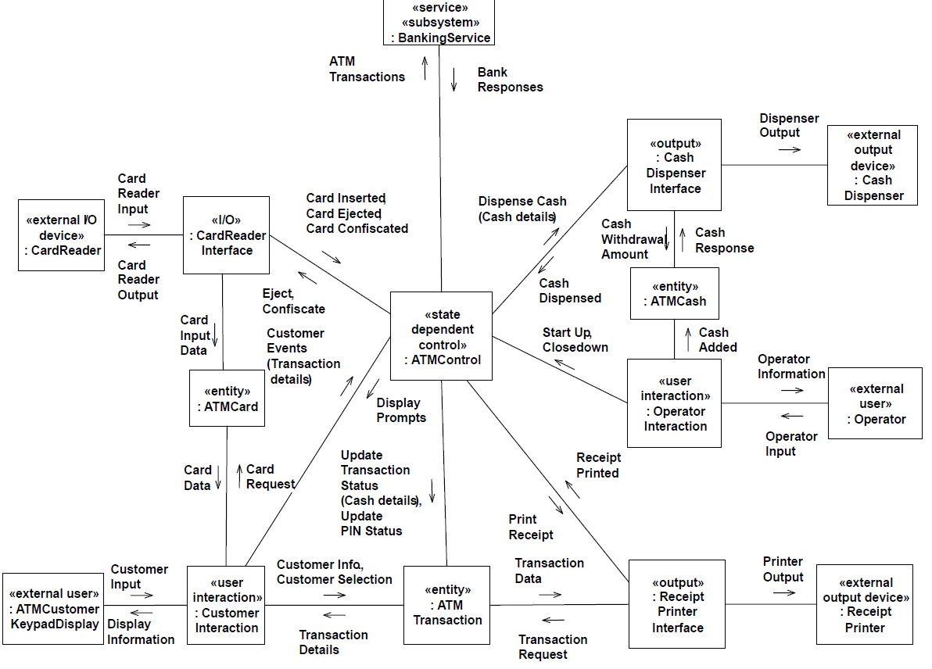
Integrated communication diagram for ATM Client subsystem

Slide 11
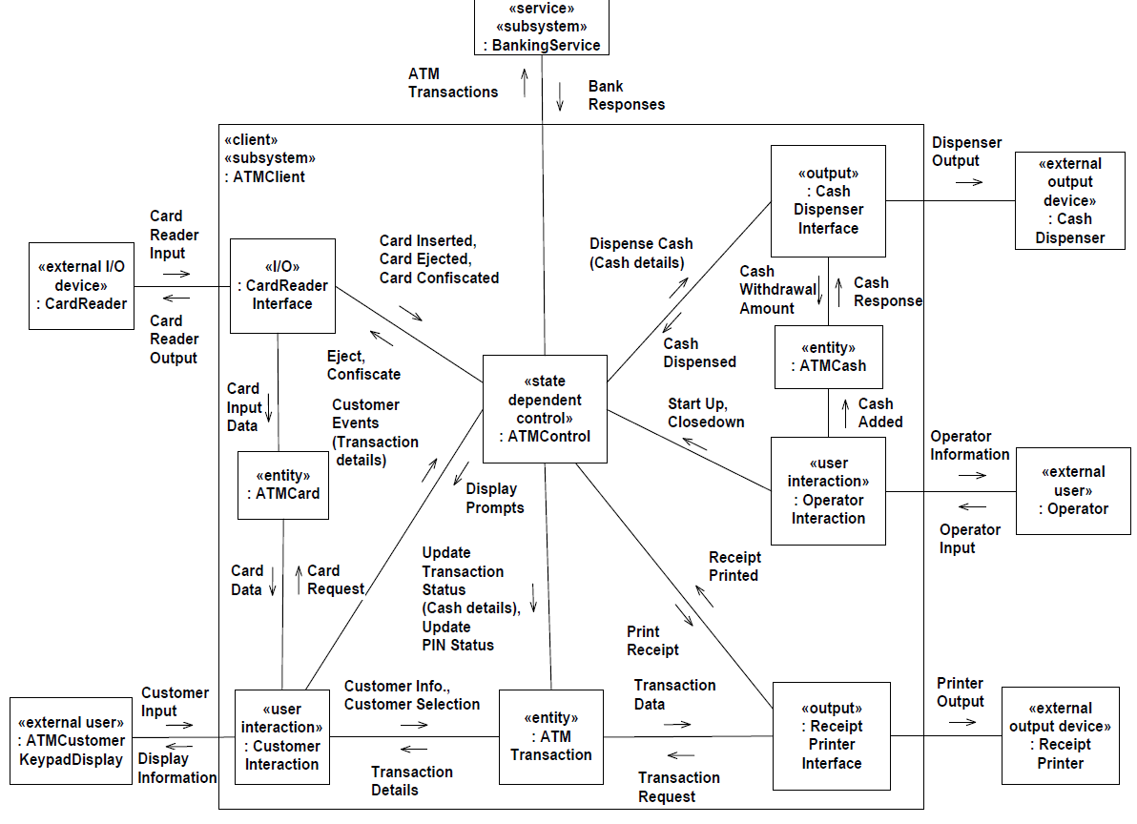
Integrated communication diagram for ATM Client subsystem

Slide 12
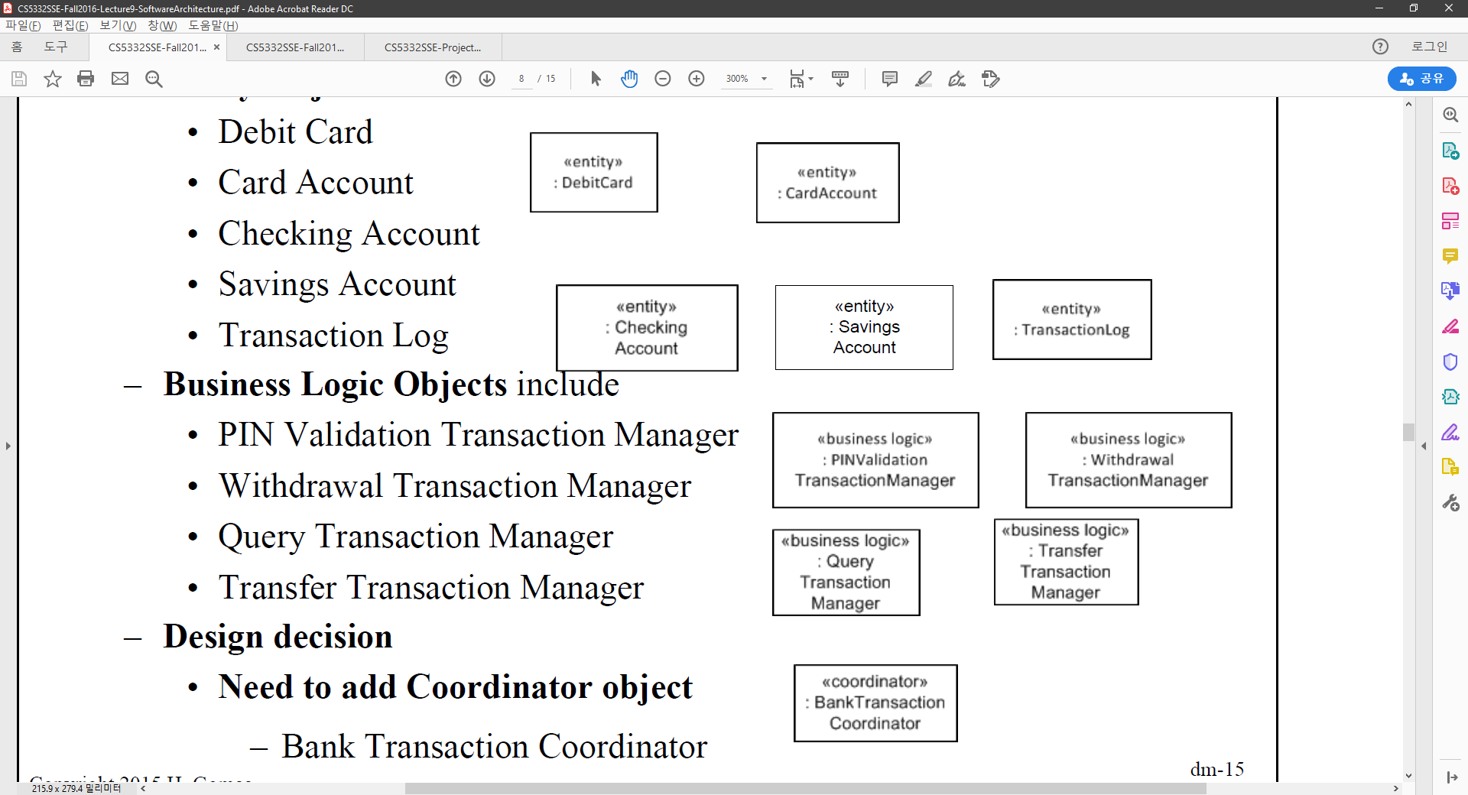
Example of Integration of communication Diagrams - Banking System
Banking Service Objects
Entity Objects
Debit Card
Card Account
Checking Account
Savings Account
Transaction Log
Business Logic Objects include
PIN Validation Transaction Manager
Withdrawal Transaction Manager
Query Transaction Manager
Transfer Transaction Manager
Design decision
Need to add Coordinator object
Bank Transaction Coordinator

Slide 13
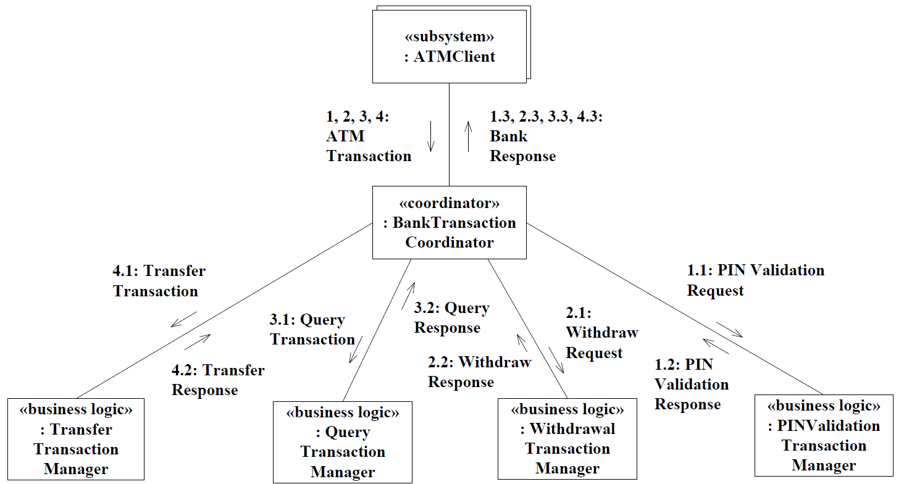
Coordinator object
Decision making object
Decision based on input received
Bank Transaction Coordinator is needed to forward ATM transaction
To a business logic object

Slide 14
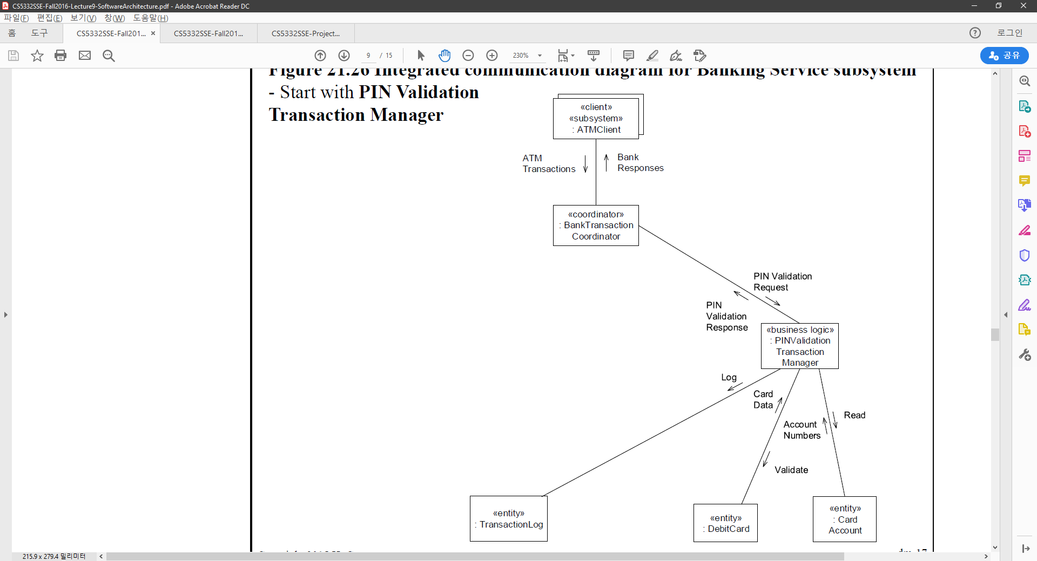
Integrated communication diagram for Banking Service subsystem - Start with PIN Validation Transaction Manager

Slide 15
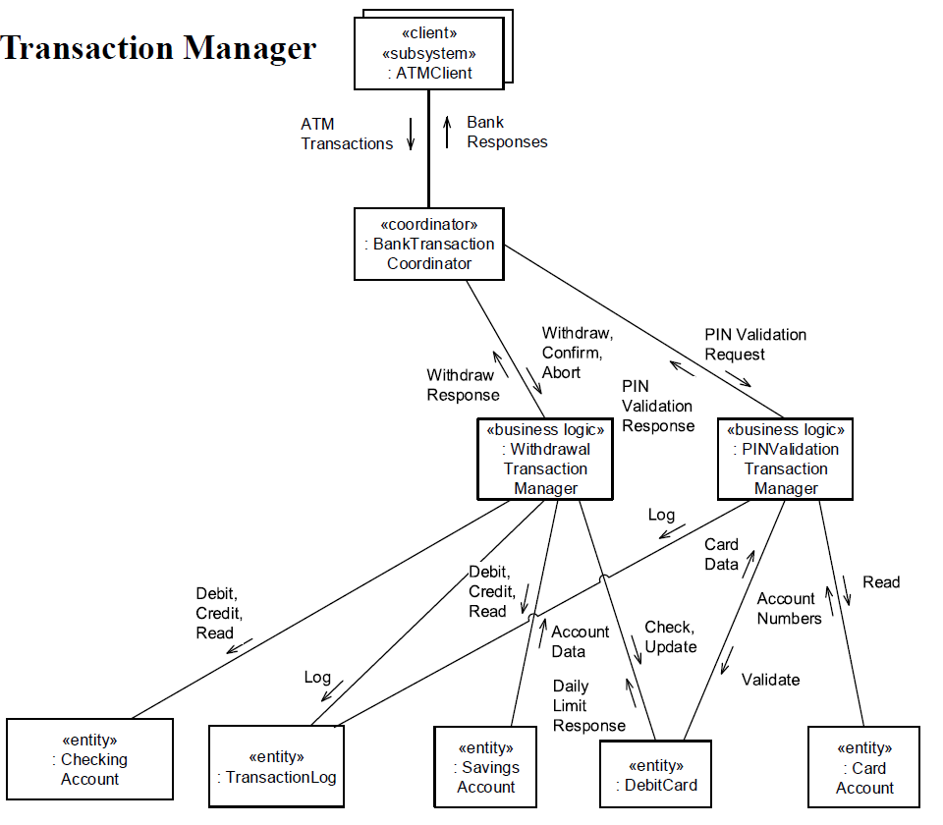
Integrated communication diagram for Banking Service subsystem – Add Withdrawal Transaction Manager

Slide 16
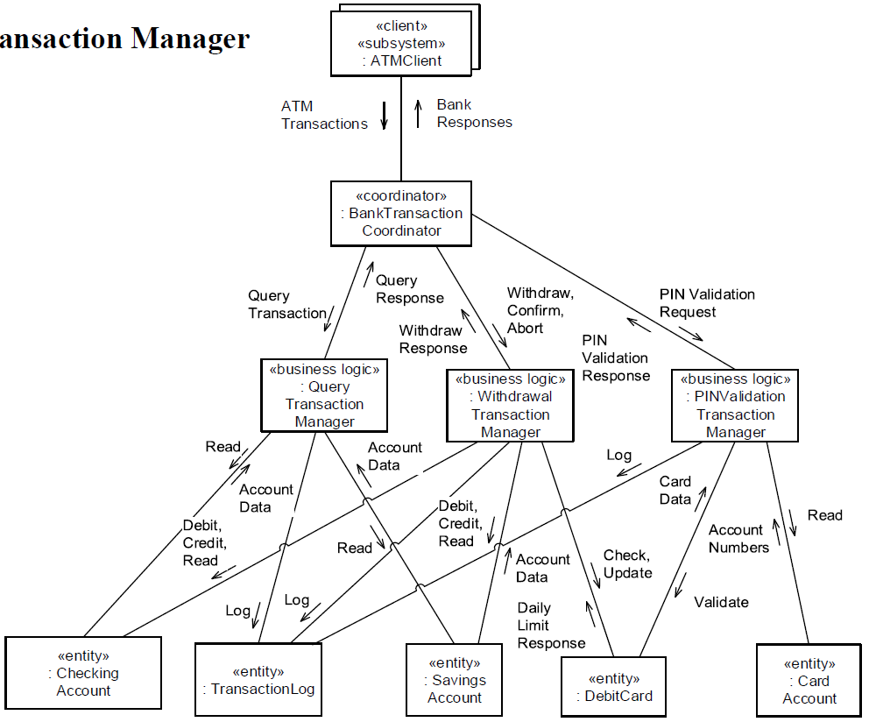
Integrated communication diagram for Banking Service subsystem – Add Query Transaction Manager

Slide 17
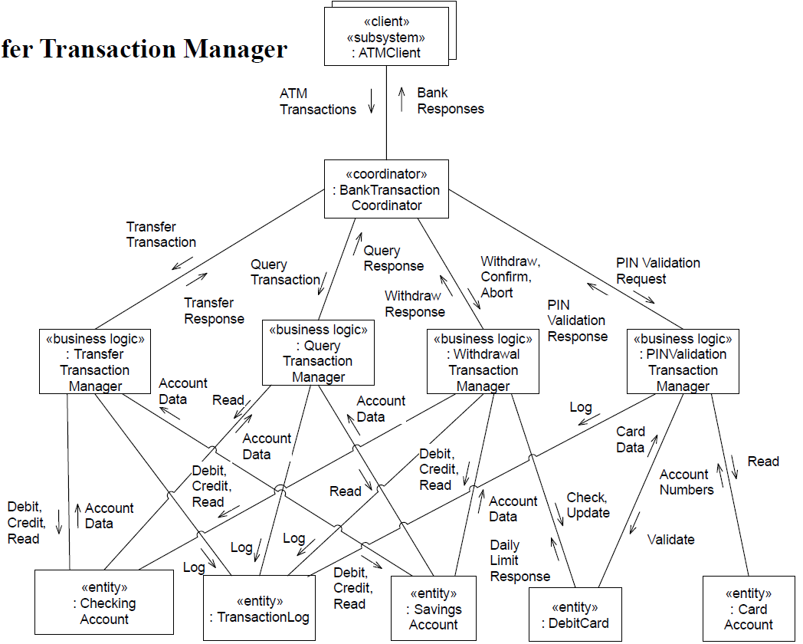
Integrated communication diagram for Banking Service subsystem – Add Transfer Transaction Manager

Slide 18
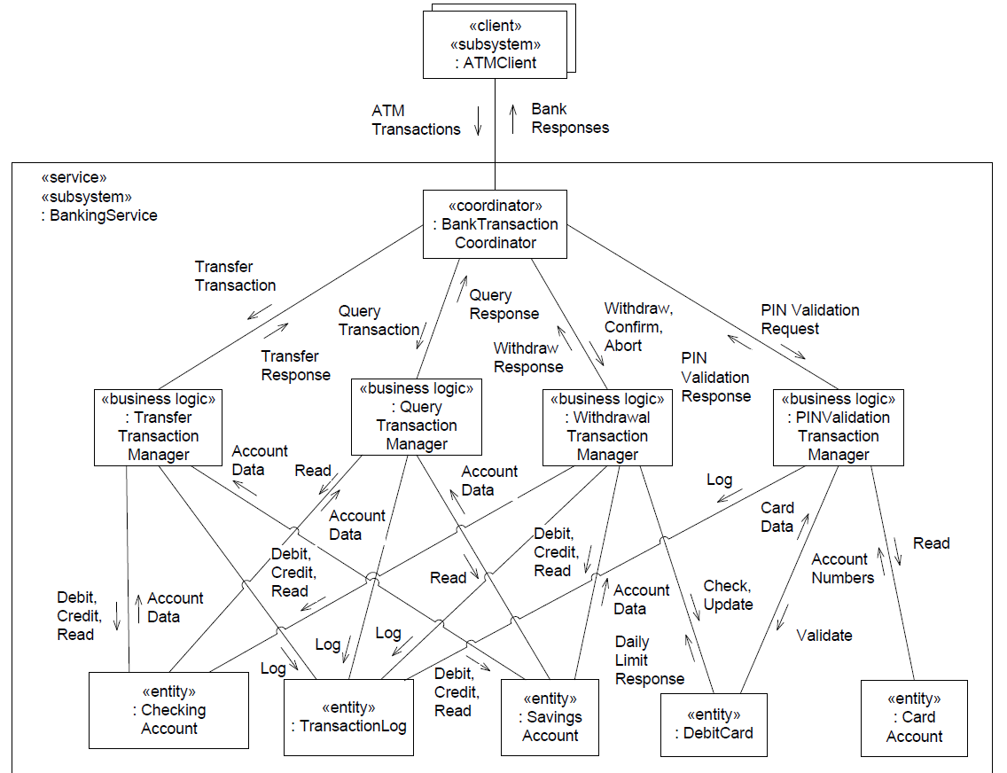
Integrated communication diagram for Banking Service subsystem

Slide 19
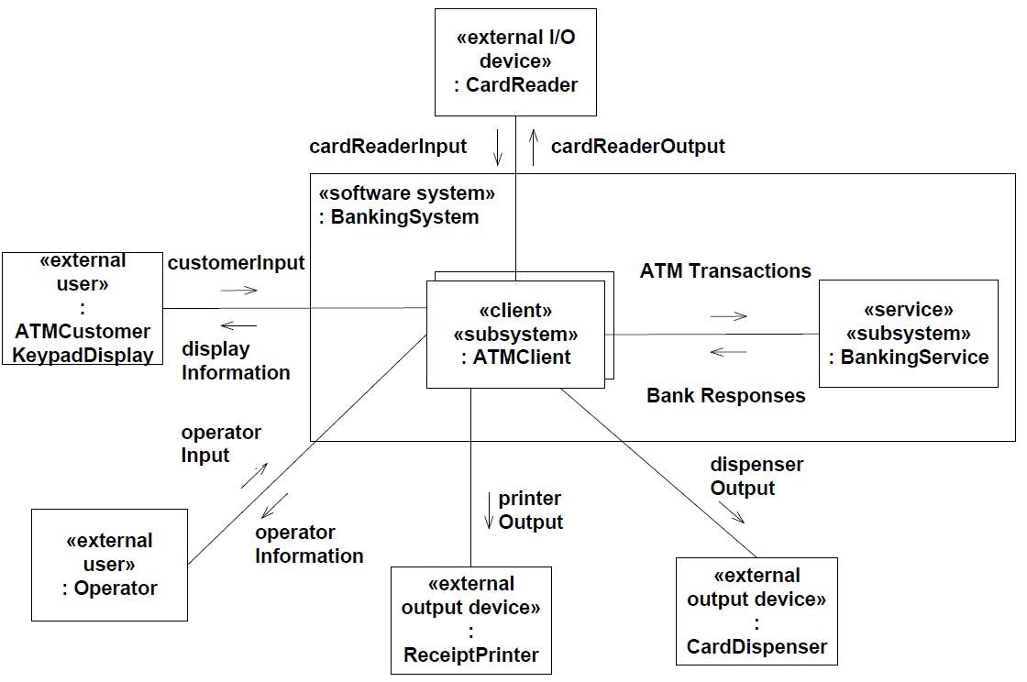
Subsystem design – high level communication diagram for Banking System

Slide 20
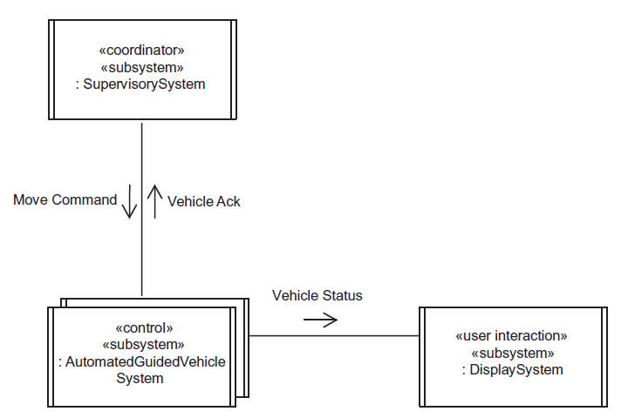
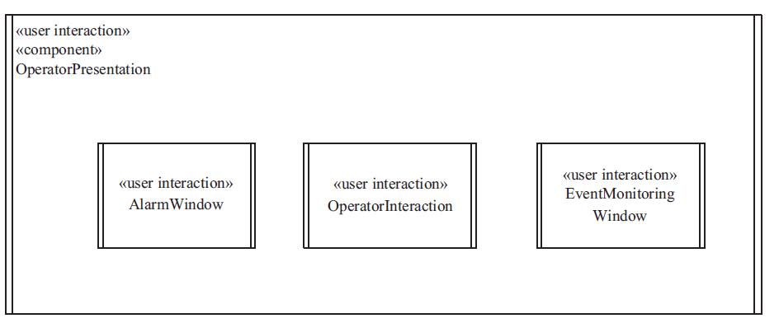
Subsystem Structuring Criteria
User Interaction
Collection of objects supporting needs of user
Control
Subsystem controls given part of system
Coordinator
Coordinates several control subsystems

Slide 21
Design Distributed Subsystem Interfaces
Message Communication between distributed subsystems
Asynchronous message communication
Peer to peer communication
Synchronous message communication
Client / Service message communication
Group Message Communication
Broadcast message communication
Multicast message communication
Brokered Communication
Uses Object Broker

Slide 22
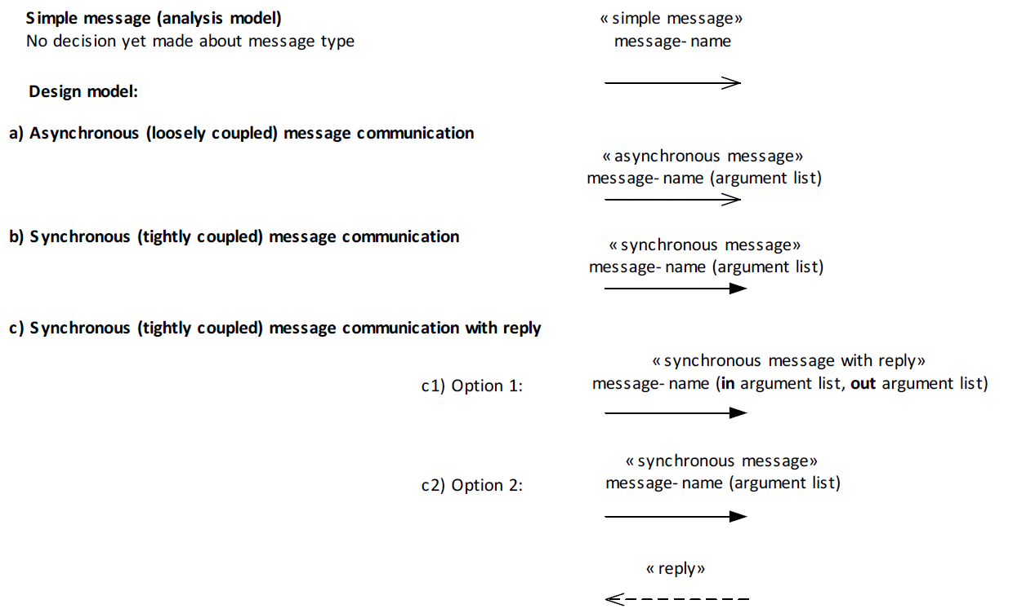
UML notation for messages

Slide 23
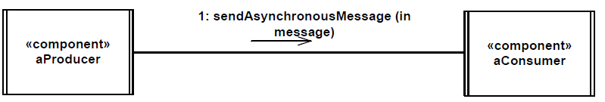
Asynchronous Message Communication (Loosely Coupled)
Producer sends message and continues
Consumer receives message
Suspended if no message is present
Activated when message arrives
Message queue may build up at Consumer

Slide 24
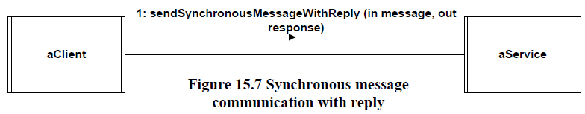
Synchronous Message Communication with Reply (Tightly Coupled)
Client task sends message and waits for reply
Service receives message
Suspended if no message is present
Activated when message arrives
Generates and sends reply
• Client receives reply and continues

Slide 25
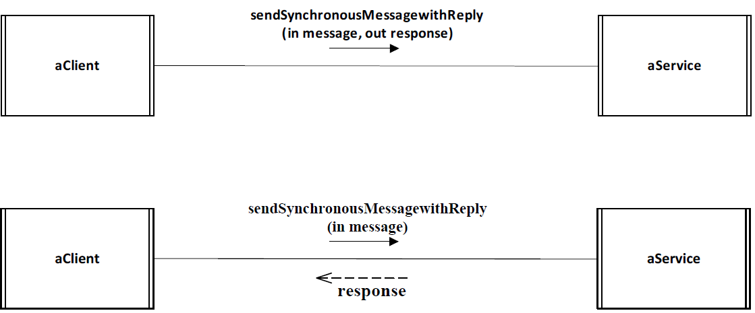
Synchronous Message Communication with Reply - Two UML notations – either one can be used

Slide 26
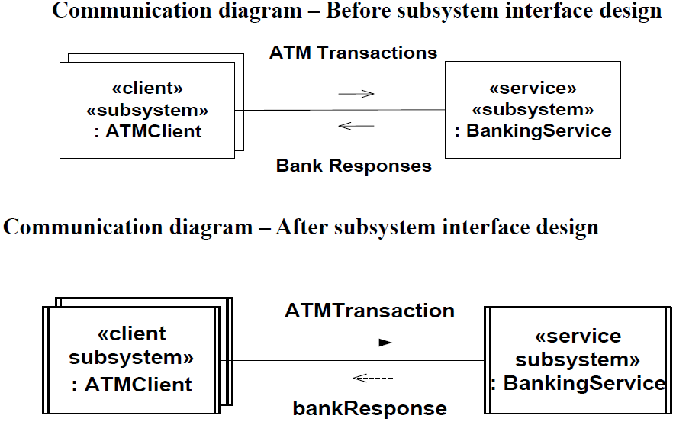
Example of Synchronous Message Communication With Reply

Slide 27
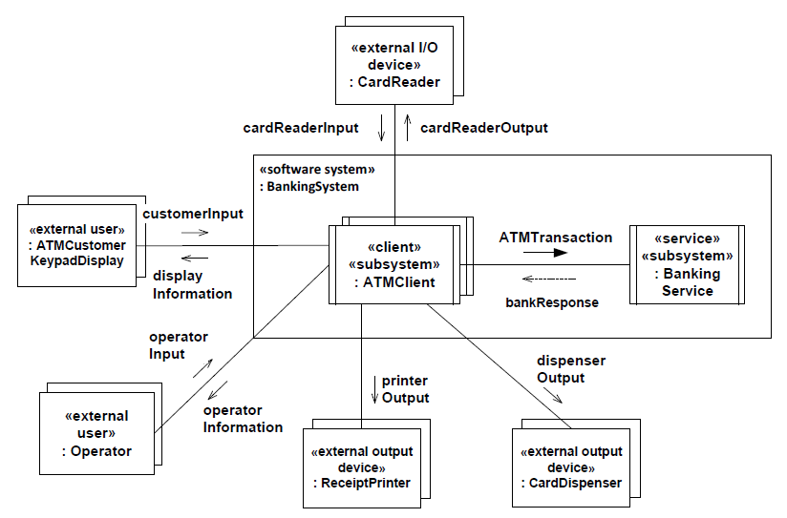
Design of Subsystem interfaces –high level communication diagram for Banking System

Slide 28
Summary of phase 3
Tasks
1. Start from integration of communication diagrams to one big communication diagram
2. Group objects that performs similar functionality or depending on roles and create subsystem
For each subsystem show what objects are inside the subsystem and how they are connected
3. Re define instruction on edges on integrated communication diagram as they are merged.
4. Create higher level communication diagram using subsystems and regular objects (not included in subsytems)

